Slide 1
About SkillPlan
SkillPlan, not-for-profit, is a nationally recognized leader in workforce development programming.
With over 30 years of experience, SkillPlan provides consulting services and resources to the construction industry, with a focus on pinpointing foundational skills’ gaps, addressing learning challenges and delivering industry-specific training programs to help workers succeed in technical training and on the job.
Based in British Columbia, SkillPlan serves 14 international Building Trades unions and their affiliated contractors and technical training providers across North America.

Slide 2
TRAIN THE TRAINER
MENTORSHIP
Building a stronger industry
Mentoring Principles
Step 1: Identify the Point of the Skill
Step 2: Link the Skills
Step 3: Demonstrate the Skill
Step 4: Provide Opportunity for Practice
Step 5: Give Feedback
Step 6: Assess Progress
Successful mentorship is a critical element in building a high-quality workforce and is key to developing qualified journeypersons.
Especially in the trades, where 80% of learning happens on the job, mentorship has been shown to positively affect productivity, safety, quality and retention.
Apprentice Principles
Skill 1: Effective Communication
Skill 2: Active Listening
Skill 3: Receiving Feedback
Skill 4: Asking Questions
Skill 5: Proactive Learning
Skill 6: Setting Goals

Slide 3
ON-THE-JOB TOOLS
Jobsite mentorship orientation
Guidelines for mentorship discussions at toolbox and safety meetings
Online mobile app for tracking competencies, mentorship skills and progress
Survey summary reports
Hard hat decals

Slide 4
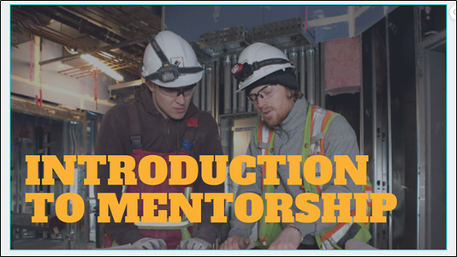
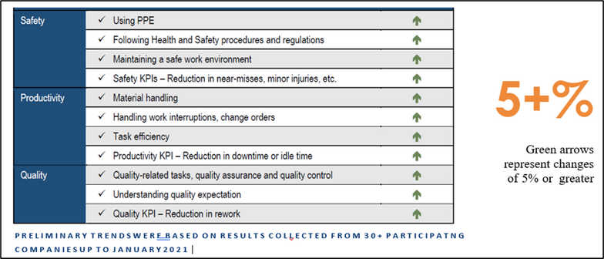
MENTORSHIP ROI STUDY
SIX PRINCIPLES FOR A SAFE, PRODUCTIVE, AND HIGH-QUALITY WORKFORCE
Needs analysis with 1200+ stakeholders to validate mentorship framework
Implementation of mentorship programs with over 30 contractors that resulted in over 1,500 workers trained
Training framework, program and tools implemented within the workplace and in technical training for the construction sector
Baseline data collected for 30 firms and surveys and assessments from 1,000+ participants
To review the full report please contact SkillPlan
Mentoring Principles
Step 1: Identify the Point of the Skill
Step 2: Link the Skills
Step 3: Demonstrate the Skill
Step 4: Opportunity for Practice
Step 5: Give Feedback
Step 6: Assess Progress
Apprentice Principles
Skill 1: Effective Communication
Skill 2: Active Listening
Skill 3: Receiving Feedback
Skill 4: Asking Questions
Skill 5: Proactive Learning
Skill 6: Setting Goals

Slide 5
MENTORSHIP IMPACTS
Apply industry best practice in knowledge and skill transfer between journeypersons and apprentices.
12.1% increase
9.2% reduction
Increase in the proper use of PPE
Reduction in complacency in health & safety procedures
35.7% improvements
44.4% increase
$1 invested = $2
Improvements in task efficiency
Increase in mentors giving challenging tasks to extend apprentice skills & abilities
For every $1 invested = $2*
15.6% reduction
42% reduction
Reduction in rework
Reduction in downtime

Slide 6
NABTU Pilot Project 2022
Mentorship
60+ TRAINERS
1200+ APPRENTICES & MENTORS TRAINED
Bricklayers and Allied Craftworkers, Ohio
Ironworkers 29, Portland
Electrical JATC, Baltimore
Electrical JATC, Charlotte
All the participants said that they thought the training was great and they are looking forward to the next steps. The entire group is on board with implementing this into our program.

Slide 7
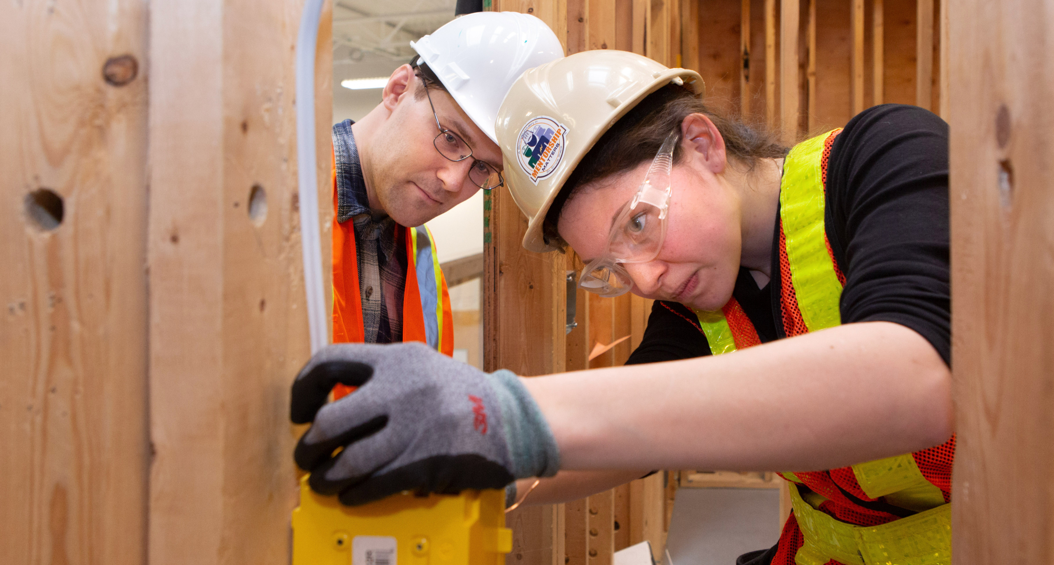
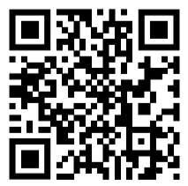
MENTORSHIP
skillplan.ca/products
BUILD AND RETAIN A HIGH-QUALITY WORKFORCE
For over 20 years, tens of thousands of apprentices and journeypersons across North America have been trained using our Mentorship program, with proven results in increased skills acquisition, productivity and safety, communicationenhanced job satisfaction and retention.

